Slide 1
DARA
Data Analysis Recommendation Assistant
Yoel Kortick
Senior Librarian

Slide 2
Agenda
Introduction
Types of Recommendations
DARA Configurations
Accessing DARA
Filtering DARA Recommendations
Assigning DARA Recommendations
Managing DARA Recommendations
DARA Recommendations Based on Analytics
Live Example – Link Electronic Resources to the Community
Live Example – Missing Items
Live Example – Identical OCLC Control Number
2

Slide 3
Introduction

Slide 4
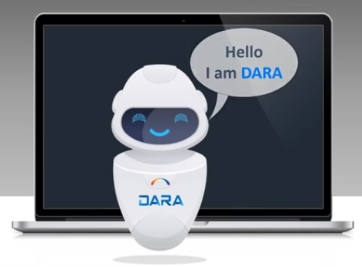
Introduction
DARA is Alma’s Data Analysis Recommendation Assistant

Slide 5



Introduction
Why DARA?
Librarians are dealing mostly with daily routines but are expected to do more | Alma is growing with additional features every month | The Alma community big data is a true asset that can assist librarians
What should I do to optimize my work?

Slide 6
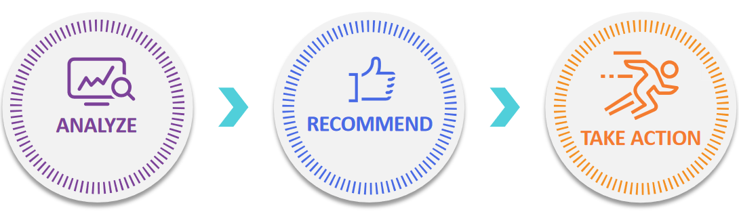
Introduction
What can we do with the analyzed data?
Adaptive - Right time, right place, relevant to user profile and behavior

Slide 7
Introduction
DARA uses
  AI (Artificial Intelligence)
  ML (Machine Learning)
  Alma Analytics
DARA assists the library by
  Recommending workflow efficiencies
  Suggesting features
  Validating configurations.

Slide 8
Introduction
DARA is used to leverage
  The cloud
  The community
  The size of Alma
In order to allow the staff users to work smarter

Slide 9
Types of Recommendations

Slide 10
Types of Recommendations
There are currently 22 different recommendation types in 15 different categories.
These are explained in the table at DARA – Data Analysis Recommendation Assistant where it states “The following chart lists the currently available recommendations from DARA:”
If there are additional ideas for a new DARA recommendations, they should be submitted via the Idea Exchange

Slide 11
Types of Recommendations
There are three types of DARA Recommendations:
Feature Recommendations
Analytics Based Recommendations
System Based Recommendations

Slide 12
Types of Recommendations – Feature Recommendations
Feature Recommendations:
  Based on use of features across the community and specific institution setup, recommend use of a feature that is not in use
  Examples:
    Automate MD Import Profiles
    Convert Audio/Video Files to Streaming/HTML5 format
    Description Templates
    Fully Utilize Digital Asset Management Flows
    Group Standalone Portfolios
    My Electronic Resources by Provider
    New Digital Viewer
    Upload Electronic Holdings
    Validate Order Information for Orders Created by API

Slide 13
Types of Recommendations – Analytics Based
Analytics Based Recommendations:
  Population is based on a report
  Examples:
    High Request Load
    Identical OCLC Control Number
    Missing Items
    Non-handled Requests
    Unavailable portfolios

Slide 14
Types of Recommendations – System Based
System based Recommendations:
  System determines recommendations based on internal DARA logic
  Examples:
    Automatic Usage Data
    Job Failure
    Link Electronic Resources to the Community
    Link Local Electronic Collections to the CZ
    Link Standalone Portfolios to CZ
    Load Usage Data
    No Data Processed
    No Job Instance

Slide 15
Types of Recommendations
Automate MD Import Profiles DARA identifies if the institution is manually importing via an MD import and if so recommends that the MD import profile be scheduled. Additionally, DARA can identify that there is an MD import profile configured without the vendor’s FTP details. DARA recommends that the MD import profile be configured to access the relevant FTP server and to add scheduling to the profile.
Automatic Usage Data DARA identifies instances where the institution has manually uploaded a COUNTER file and suggests that a SUSHI account be created so that the usage information can be harvested automatically. This is only recommended if DARA knows that other institutions are able to harvest successfully from this vendor.
Convert Audio/Video Files to Streaming/HTML5 format DARA identifies when the institution has files that are incompatible with HTML5 formats and cannot be viewed using native viewers in Alma. DARA recommends that and recommends that the Media Conversion job be run on files of formats wmv, avi, m4v or mp4v and convert them to MPEG-4 or HTTP Live Streaming (HLS) formats.

Slide 16
Types of Recommendations
Description Templates DARA identifies that you have not configured description templates, which are used to generate descriptions for physical items based on ENUM/CHRON information and directs you to configure them.
Fully Utilize Digital Asset Management Flows DARA identifies when you have created digital inventory, but do not have a full subscription to Alma Digital. DARA informs you of the licensing terms for full utilization of Alma Digital.
Group Standalone Portfolios DARA identifies that you have standalone portfolios with the same base URL that probably belong to the same provider and recommends that you group them into a local collection. For information on how to ungroup the portfolios, see Adding a Set of Standalone Local Portfolios to a Local Electronic Collection and Using Portfolio Loader for Adding, Updating or Removing Portfolio Information in Bulk.

Slide 17
Types of Recommendations
High Request Load Using an Alma Analytics report, DARA identifies physical items with multiple patron physical requests. Items are included here for which the time until an item became available for this title was relatively long. DARA recommends reviewing the title to potentially reduce the patron waiting time. This might be done by modifying the terms of use for these items, moving them to a short loan location or purchasing additional copies of this title. These options might reduce the time until a requested item becomes available and improve patron satisfaction.
Identical OCLC Control Number Using an Alma Analytics report, DARA identifies if you have multiple bibliographic records with the same OCLC number in the 035$a field and recommends that you create a set to review bibliographic records to see if there are records in which the system control number should be corrected. Correcting BIB records can be done by running a normalization rule on the set of titles.

Slide 18
Types of Recommendations
Job Failure DARA determines that a job failed several times in a short interval (default: 3 times in the last 10 days) and recommends that you check the job report. The relevant jobs are the SIS Synchronization job and the MD Import job. You can configure the number of times and the time period that a job must fail before a recommendation is triggered. For more information, see Configuring the Job Failure Recommendation.
Link Electronic Resources to the Community Currently, the Local Portfolios in Community-Linked Collection type is available. With this recommendation, DARA identifies when there are local portfolios in Electronic Collections that are available in the community zone and recommends that they be linked to the CZ. Linking to the community zone enables the institution to receive updates automatically, without the need to update the portfolios manually.
Link Local Electronic Collections to the CZ DARA identifies when there are local Electronic Collections that can be linked to the Community Zone. Linking to the Community Zone enables the institution to receive updates automatically without the need to update manually.

Slide 19
Types of Recommendations
Link Standalone Portfolios to CZ DARA identifies when there are local standalone portfolios that can be linked to the Community Zone. Linking to the Community Zone enables the institution to receive updates automatically without the need to update the portfolio manually.
Load Usage Data DARA identifies that the institution does not upload usage data from a specific vendor even though the institution does have active collections from that vendor. DARA suggests that a SUSHI account be created and have the usage information harvested automatically. This is only recommended if DARA knows that other institutions are able to harvest successfully from this vendor.
Missing Items Using an Alma Analytics report, DARA identifies items which have been in missing status for a long time. DARA recommends reviewing the item in order to decide how it should be handled: Some institutions create a dedicated work order to try to find the item. If the item is found, remove the "missing" status. If the item is really missing, the institution should consider withdrawing the item.

Slide 20
Types of Recommendations
My Electronic Resources by Provider DARA determines that the My Electronic Resources by Provider feature in Alma is relevant for the institution, but is not in use, and recommends that it be used.
New Digital Viewer DARA identifies that you have not yet configured the new Digital Viewer and recommends that you do so.
No Data Processed DARA determines that a job did not process any data for several days (default: 5) and recommends that you check the job report. The relevant jobs are the SIS Synchronization job and the MD Import job.
No Job Instance DARA determines that a job did not run recently (default: the last 3 days) and recommends that you check the job report. The relevant jobs are the SIS Synchronization job and the MD Import job.

Slide 21
Types of Recommendations
Non-handled Requests Using an Alma Analytics report, DARA identifies requests taking a long time to process and recommends reviewing them. By default, the recommendation is generated when the institution has at least 5 requests that have not been handled for at least 25 days. You can customize the report to produce recommendations that better suit the needs of your institution. The report is located in your analytics institution folder under /Shared Folders/Your institution/reports/DARA. If the analytics report does not exist, DARA copies the report from the Shared/Alma/DARA folder into your institution folder
Unavailable portfolios Using an Alma Analytics report, DARA identifies unavailable electronic portfolios and recommends that they be activated. The report is located in the analytics institution folder under /Shared Folders/Your institution/reports/DARA.

Slide 22
Types of Recommendations
Upload Electronic Holdings DARA identifies if there are Electronic Collections that were not uploaded with an integration profile from vendors that support automatic upload of electronic holdings. DARA recommends that the integration profile be configured for supported vendors. One recommendation is produced for each supported vendor.
Validate Order Information for Orders Created by API DARA identifies that although the New Order Integration profile has been configured, and PO lines have been created by an API, none of the Validation of Order Information options for the New Order API integration profile have been selected. These options prevent the API from creating new orders without proper funding.

Slide 23
DARA configurations

Slide 24
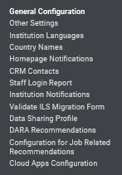
DARA configurations
There are two configurations regarding accessing and using DARA
The Data Sharing Profile needs to have ‘Yes" for section "Recommendations“
  General > General Configuration > Data Sharing Profile
The desired DARA Recommendations need to be active in the list of configurable DARA recommendations (as we will soon see)
  General > General Configuration > DARA Recommendations

Slide 25
DARA configurations
DARA is available to institutions with "Yes" specified as such in the Data Sharing Profile.
This is in the section "Recommendations" at "Configuration > General > General Configuration"

Slide 26
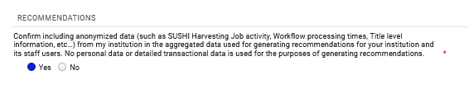
DARA configurations
This is the “Recommendations” section of the Data Sharing Profile which means that DARA will be used in the institution

Slide 27
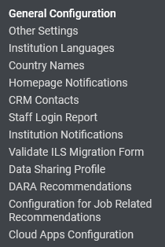
DARA configurations
DARA Recommendations are configured on the "Configuring DARA Recommendations" page
This determines which DARA Recommendations will appear in Alma per staff user roles, and if the DARA Recommendations will be automictically assigned.
This page can be accessed at Configuration > General > General Configuration > DARA Recommendations:

Slide 28
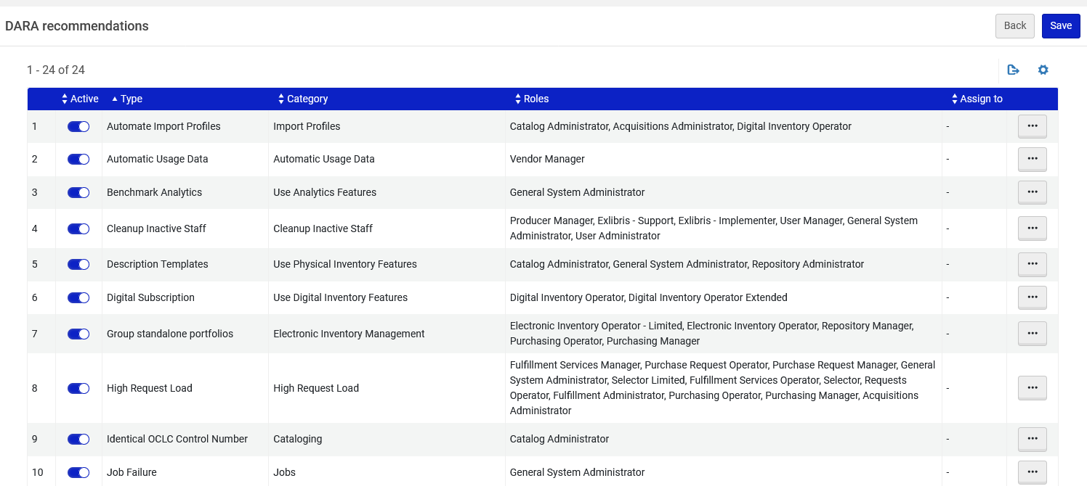
DARA configurations

Slide 29
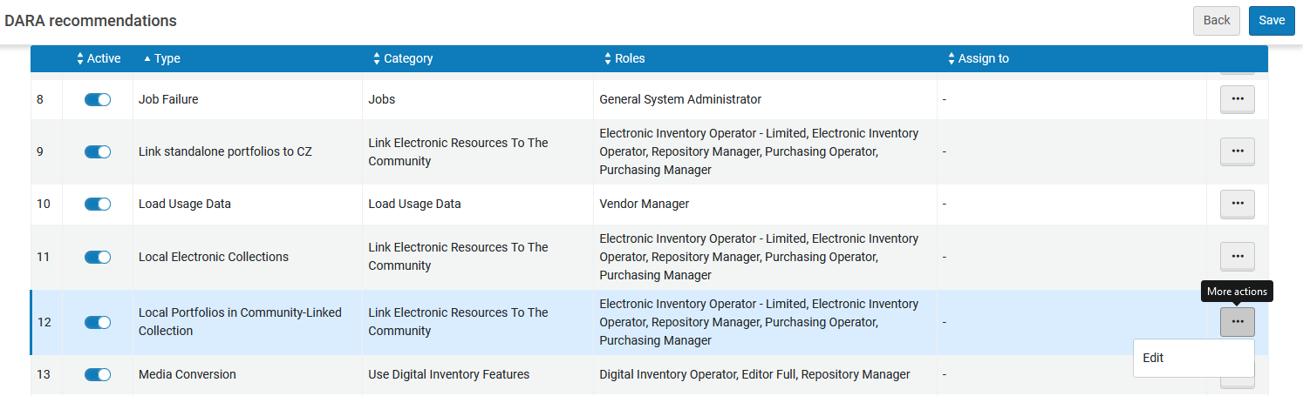
DARA configurations
We will edit the DARA Recommendation type "Local Portfolios in Community-Linked Collection" which is in category "Link Electronic Resources to the Community"

Slide 30
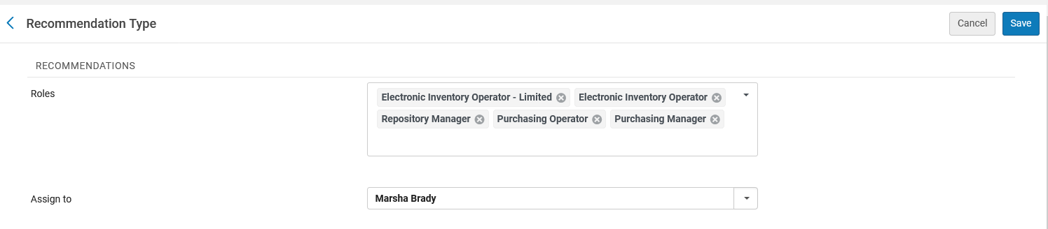
DARA configurations
When editing the recommendation type we can
Change the roles of the staff user who will see these recommendations
Have the recommendations get automatically assigned to a specific staff user
Staff users with at east one of these roles will see DARA Recommendations of type "Local Portfolios in Community-Linked Collection"
In this case DARA Recommendations of type "Local Portfolios in Community-Linked Collection" will be automatically assigned to Marsha Brady

Slide 31
Accessing DARA

Slide 32
Accessing DARA
DARA can be accessed via any of these options:
  Menu "Admin > Recommendations > Managing DARA Recommendations"
  Icon "View Recommendations" on top bar
  The "Tasks" widget

Slide 33

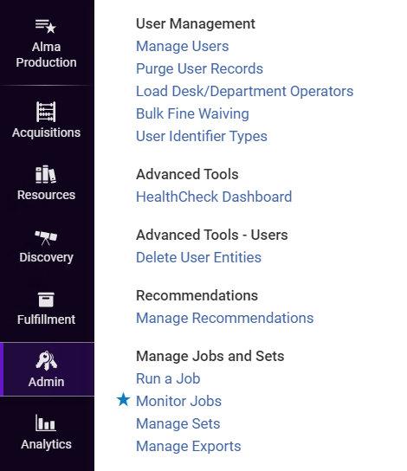
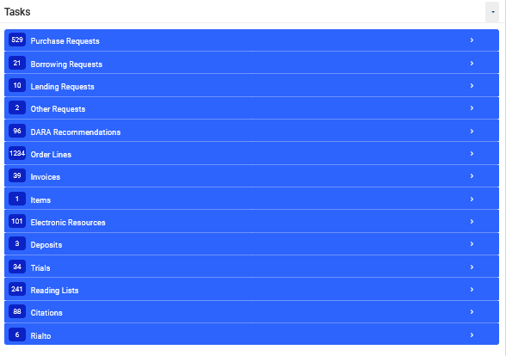
Accessing DARA
Icon "View Recommendations" on top bar
Menu "Admin > Recommendations > Manage DARA Recommendations"
The "Tasks" widget

Slide 34
Filtering DARA Recommendations

Slide 35
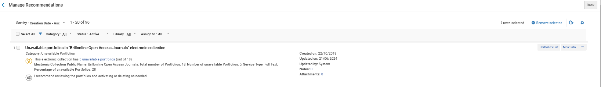
Filtering DARA Recommendations
DARA Recommendations can be filtered by
  Category
  Status (All, Active, Completed, Non-Active)
  Library
  Assignment (All , Assigned to me, Unassigned):

Slide 36
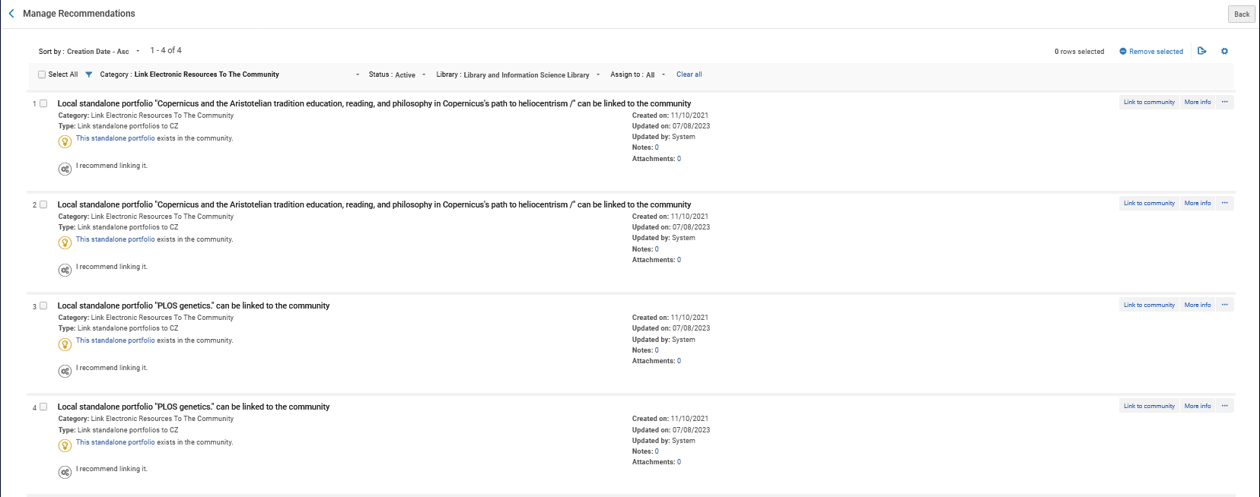
Filtering DARA Recommendations
These are DARA Recommendations filtered by "Category = Link Electronic Resources To The Community" and "Library = Library and Information Science Library"
These portfolios are associated with the Library and Information Science Library

Slide 37
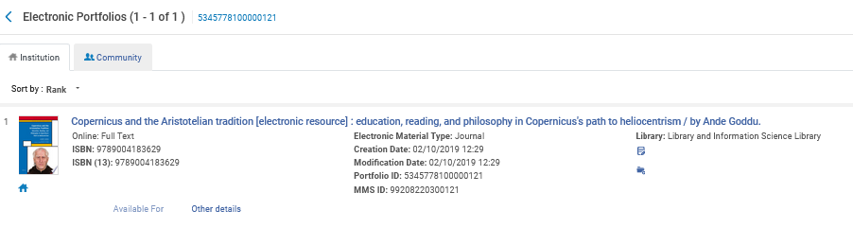
Filtering DARA Recommendations
This is the first portfolio which appeared in the previous list.
We can see that it is associated with the Library and Information Science Library

Slide 38
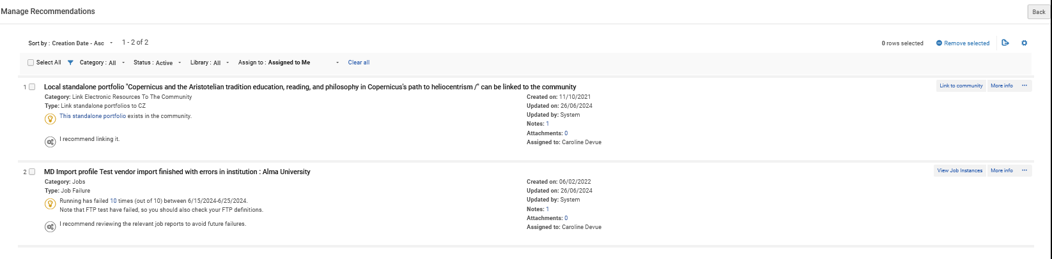
Filtering DARA Recommendations
Here the logged in staff user is Caroline Devue and she has filtered all DARA Recommendations by "Assigned to Me"
Now staff user Caroline Devue sees only Recommendations assigned to her.

Slide 39
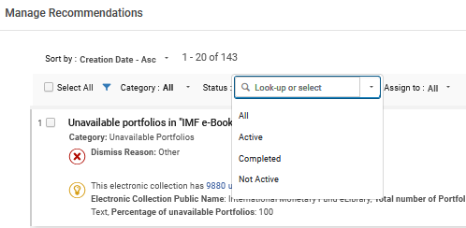
Filtering DARA Recommendations
Filter by status:
Not Active: When a recommendation is implemented, expired (not handled for 12 months), or removed, it changes to Not Active status

Slide 40
Assigning DARA Recommendations

Slide 41
Assigning DARA Recommendations
DARA Recommendations can be manually assigned via the action items for each recommendation.
Here staff user Alicia Chen (the logged-in staff user) will assign the DARA Recommendation of category "Missing Items" with name "An item of title "Harry Potter and the goblet of fire" has been missing for a long time" to a specific staff user.
We will click "Assign to"

Slide 42
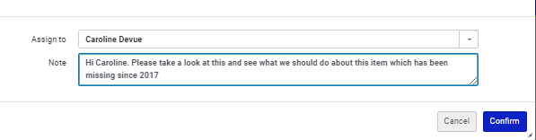
Assigning DARA Recommendations
Alicia Chen assigns the DARA Recommendation to staff user Caroline Devue and adds a note.

Slide 43
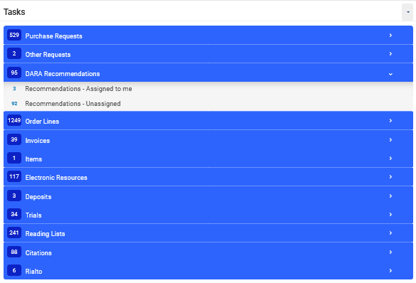
Assigning DARA Recommendations
Caroline Devue can see in her task widget that she has three DARA recommendations assigned to her (the one assigned now by Alicia Chen and two previous recommendations)

Slide 44
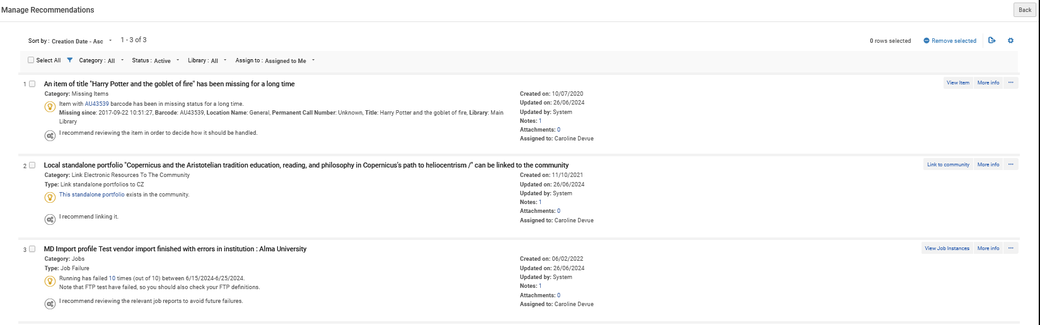
Assigning DARA Recommendations
After clicking the link from the task widget Caroline Devue is brought to the list of recommendations pre-filtered with "Assigned to Me"
This is the recommendation which we saw previously was assigned by Alicia Chen to Caroline Devue.

Slide 45
Assigning DARA Recommendations
Caroline Devue can view (and edit) the notes of the recommendation

Slide 46
Assigning DARA Recommendations
Here is the note which was added when the recommendation was assigned

Slide 47
Assigning DARA Recommendations
DARA Recommendations can also be automatically assigned by DARA Recommendation Type to a specific user.
To define this:
Edit the list of DARA Recommendations at "Configuration > General > General Configuration > DARA Recommendations"
Edit the DARA Recommendation Type which you want to be automatically assigned to a specific user
In the "Assign To" field choose the staff user to whom you want the Recommendation Type to be automatically assigned.

Slide 48
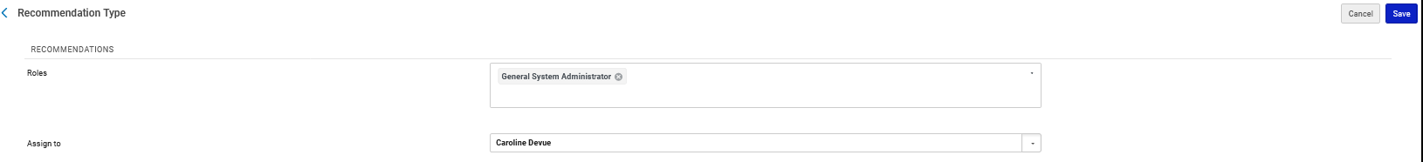
Assigning DARA Recommendations
Here we will define that DARA Recommendation Type "No Data Processed" which is in category "Jobs" will be automatically assigned to staff user Caroline Devue.
Every time a new recommendation will be created which is type "No Data Processed" in category "Jobs" it will be automatically assigned to staff user Caroline Devue.

Slide 49
Managing DARA Recommendations

Slide 50
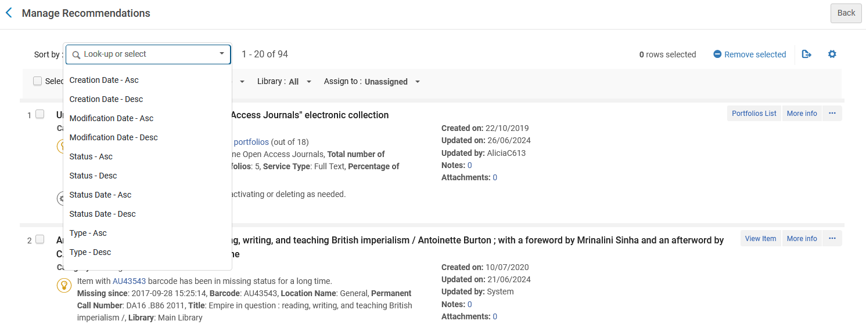
Managing DARA Recommendations
The list of DARA Recommendations can be sorted by a variety of fields, in both ascending and descending order.

Slide 51
Managing DARA Recommendations
For each DARA Recommendation a variety of activities can be performed.
Some are relevant only for Active DARA Recommendations (such as "Remove" and "Assign")
Some are relevant only for Non-Active DARA Recommendations (such as "Restore").
Some are relevant for both Active and Non-Active DARA Recommendations (such as "Edit Attachments").

Slide 52
Managing DARA Recommendations
Select the "Action Items" (three dots next to a recommendation) to:
  Assign to – Assign the recommendation to a specific staff user. Relevant only for Active DARA Recommendations.
  Remove – Remove the recommendation if you are not interested in implementing it. It will no longer appear for any staff user in the institution. It is possible to enter a reason to help DARA learn which recommendations are helpful to you. Relevant only for Active DARA Recommendations.
  Edit Notes – Add, edit and view notes for the recommendation. Notes can be used to coordinate collaboration on a recommendation between staff members. Relevant for Active and Non-Active DARA Recommendations.
  Edit Attachments – Add and view attachments for the recommendation. Relevant for Active and Non-Active DARA Recommendations.
  Restore – Make a non-Active DARA Recommendation be Active. Relevant only for Non-Active DARA Recommendations.

Slide 53
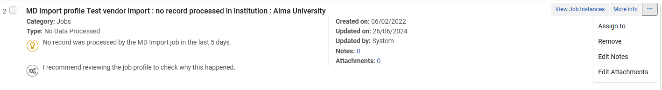
Managing DARA Recommendations
Active DARA Recommendations (Assign To, Remove, Edit Notes, Edit Attachment)

Slide 54
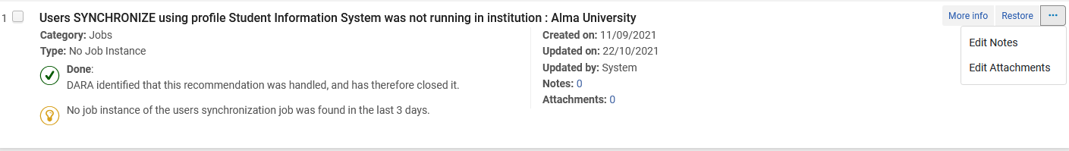
Managing DARA Recommendations
Non-Active DARA Recommendation (Restore, Edit Notes, Edit Attachment)

Slide 55
Managing DARA Recommendations
It is also possible to restore a non-active DARA Recommendation.
When a DARA Recommendation is implemented, expired (not handled for 12 months), or dismissed, it changes to Not Active status. A staff user can restore the status of the DARA Recommendation to Active.
To restore a Not Active recommendation to Active:
  Filter the DARA Recommendations by Not Active status.
  Select Restore for the DARA Recommendation.
  The recommendation's status is now Active.

Slide 56
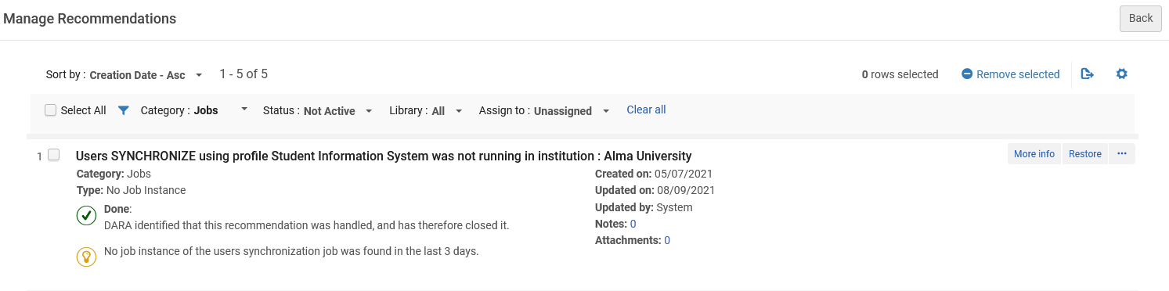
Managing DARA Recommendations
The DARA Recommendation "Users SYNCHRONIZE using profile Student Information System was not running in institution : Alma University" is not active.
We will restore it.
We will click "Restore"
Note that this is an old DARA Recommendation Created on: 05/07/2021

Slide 57
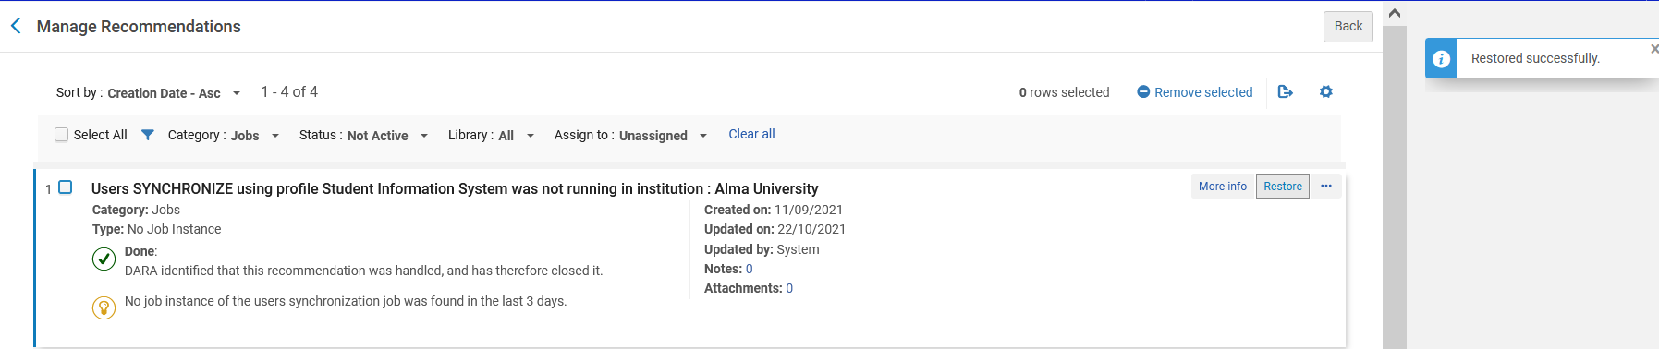
Managing DARA Recommendations
The DARA Recommendation is restored

Slide 58
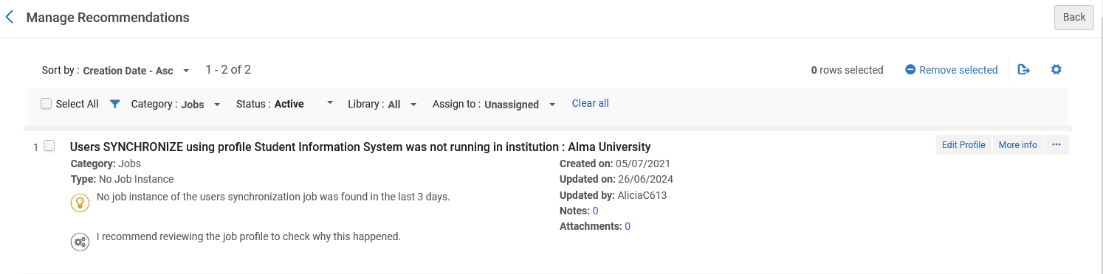
Managing DARA Recommendations
Now we see the restored DARA Recommendation under filter "Active".
Created on: 05/07/2021
Updated on: 26/06/2024

Slide 59
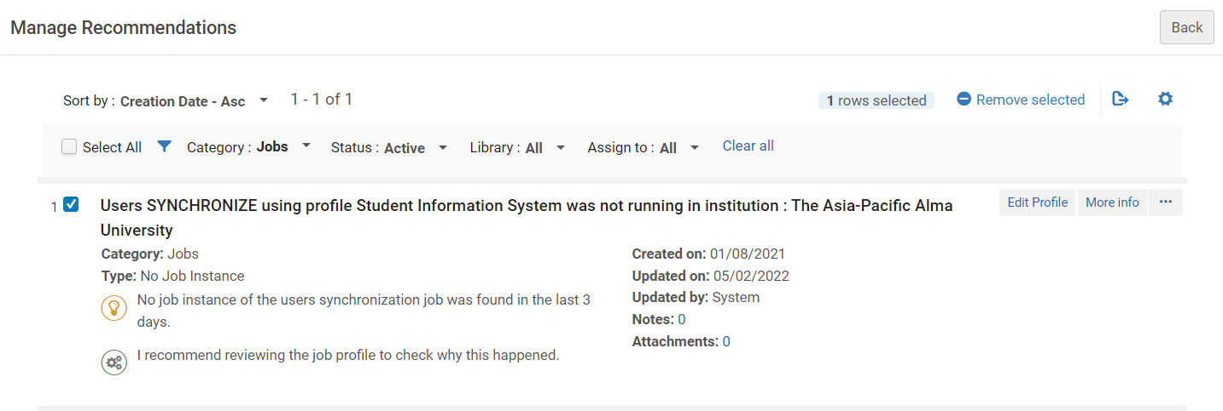
Managing DARA Recommendations
Here we have filtered by "Category: Jobs" and "Status: Active". We will remove the Active DARA Recommendation "Users SYNCHRONIZE using profile Student Information System was not running in institution : The Asia-Pacific Alma University"

Slide 60
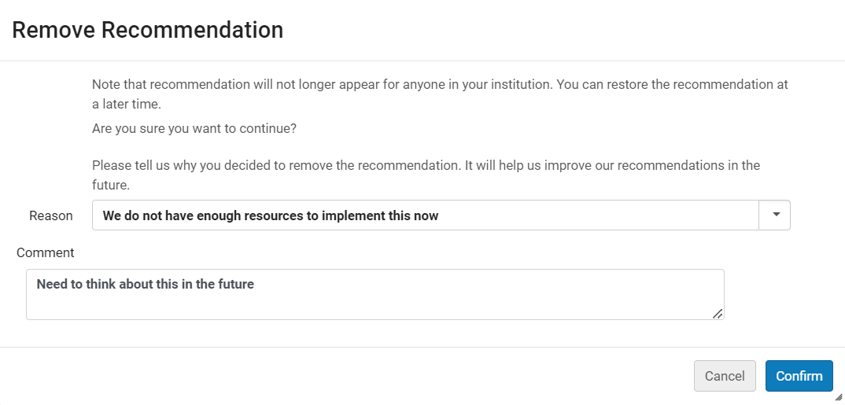
Managing DARA Recommendations
If desired, we could enter a reason and / or comment

Slide 61
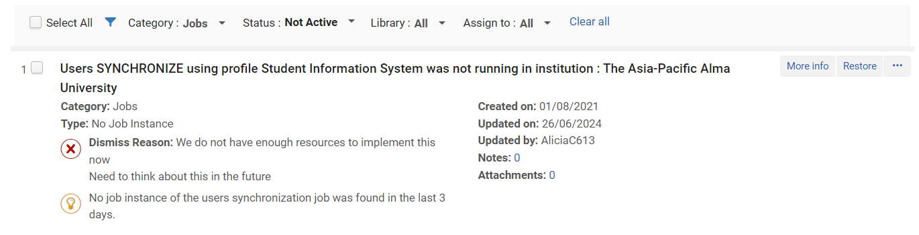
Managing DARA Recommendations
The DARA Recommendation has now become Inactive
This is the Reason and Note when entered when we removed the DARA Recommendation

Slide 62
DARA Recommendations Based on Analytics

Slide 63
DARA Recommendations Based on Analytics
The recommendations which use Alma Analytics reports take the reports from the DARA folder under the institutional folder of Alma Analytics.
  The full path is "/shared/Institution Name/Reports/DARA"
A "clean" copy of all these reports are under the Alma folder
  The full path is "/shared/Alma/DARA"
If the report is not present in the "/shared/Institution Name/Reports/DARA" folder, then it is copied by Alma from "/shared/Alma/DARA"
  In this way the institution can customize the report in their own institutional folder.

Slide 64
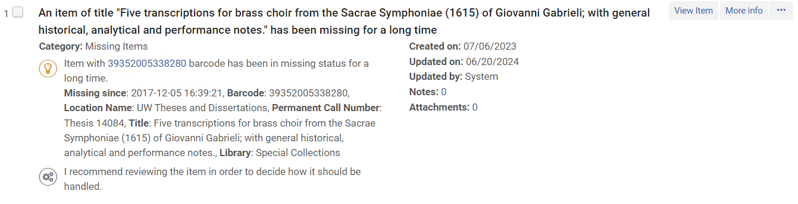
DARA Recommendations Based on Analytics
The "More Info" link from a recommendation allows the user to directly view the report. Depending on permissions the user can also edit the report.

Slide 65
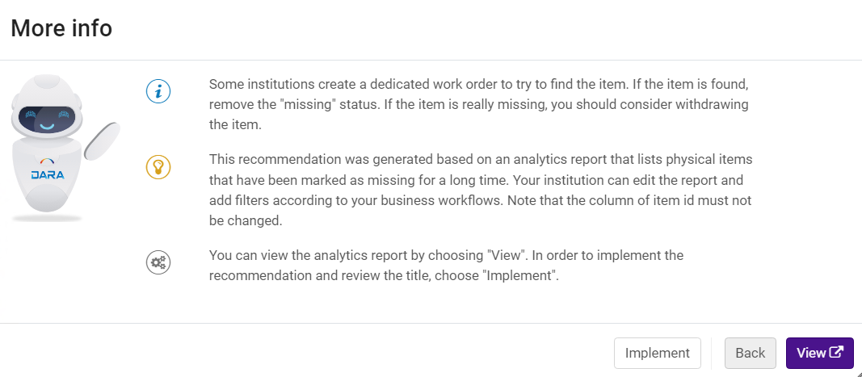
DARA Recommendations Based on Analytics
Click "View" from the "More Info" window

Slide 66
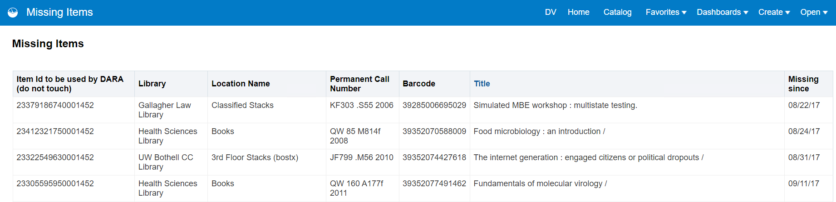
DARA Recommendations Based on Analytics
The relevant Analytics report will open (and can be viewed and edited)

Slide 67
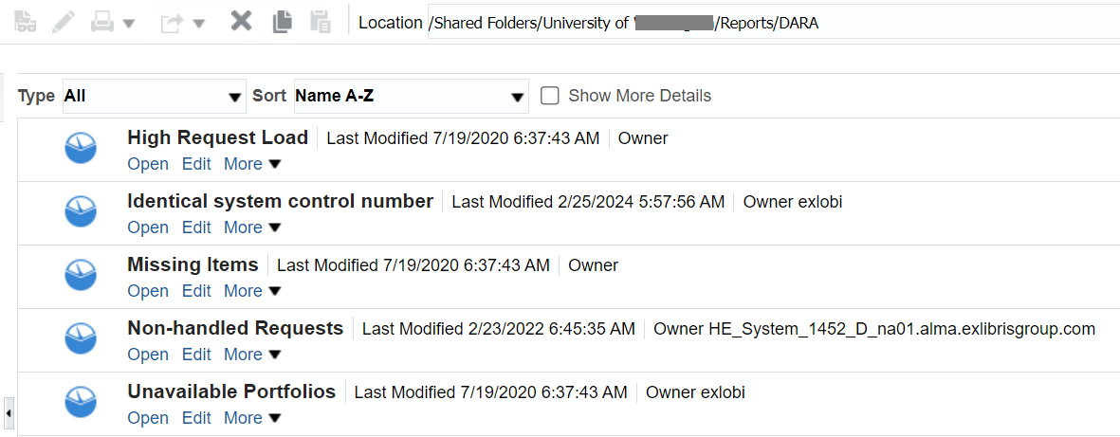
DARA Recommendations Based on Analytics
DARA Analytics reports in the institution folder

Slide 68
DARA Recommendations Based on Analytics
In our specific case the items listed in the DARA Recommendation in category "Missing Items" are based on the analytics report "Missing Items".

Slide 69
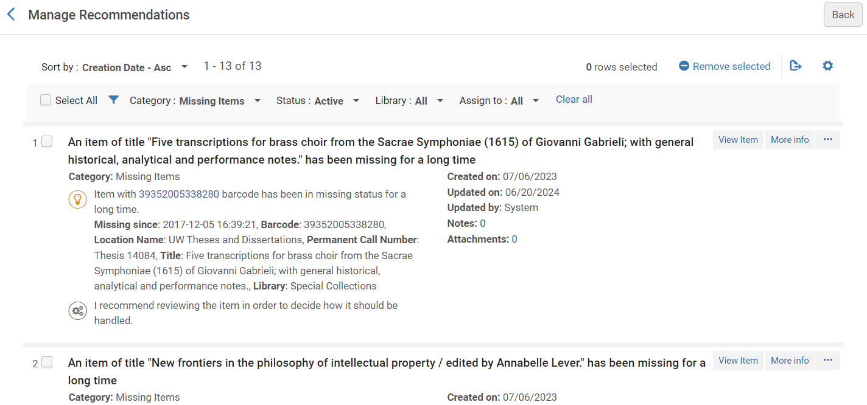
DARA Recommendations Based on Analytics
These DARA Recommendations …

Slide 70
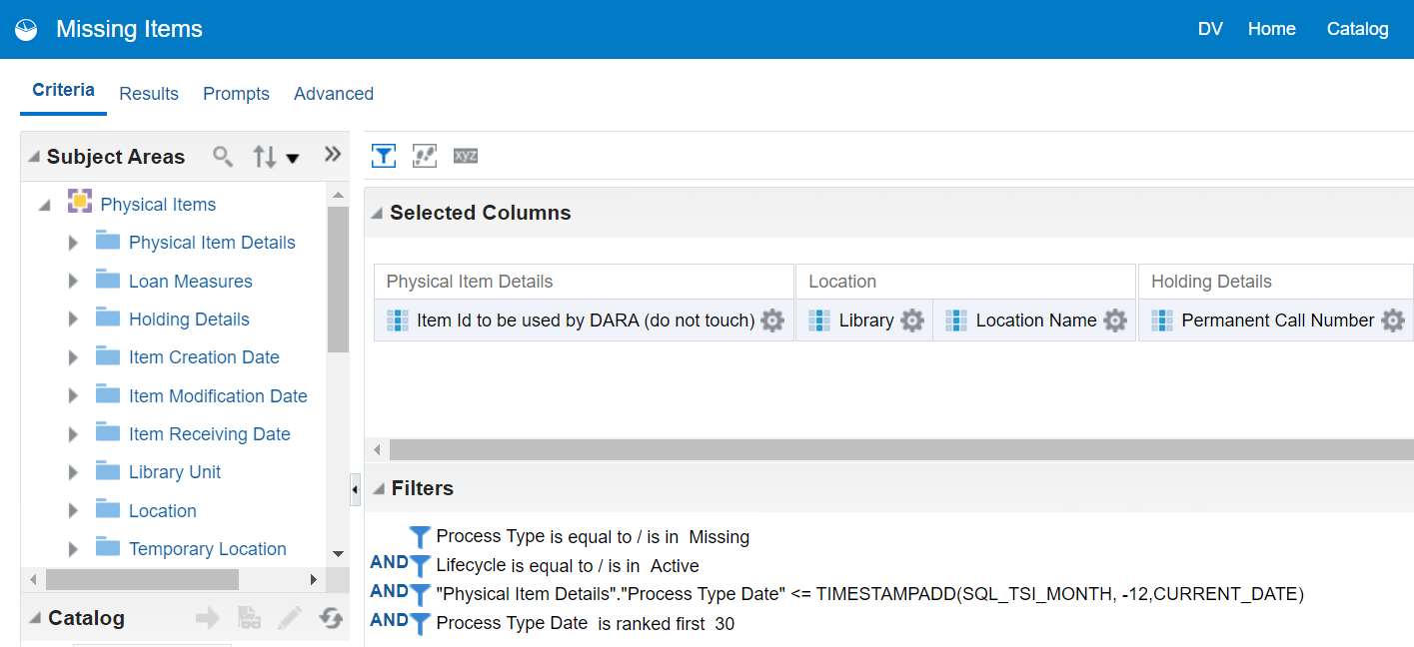
DARA Recommendations Based on Analytics
Are based on these criteria filters (which can be changed by the institution)
For example, the date filter can be changed by the institution.

Slide 71
DARA Recommendations Based on Analytics
Because the reports used by DARA are under the institution folder, the institution can change them to meet their specific needs.
For example, the recommendation category "Unavailable Portfolios" uses an Analytics report called "Unavailable Portfolios".
This report by default filters by Electronic Collection Creation Date is more than three month ago. The institution may want to change this to 5 months ago.
This report does not filter by portfolio material type. The institution may want to add a filter that portfolio material type equals book

Slide 72
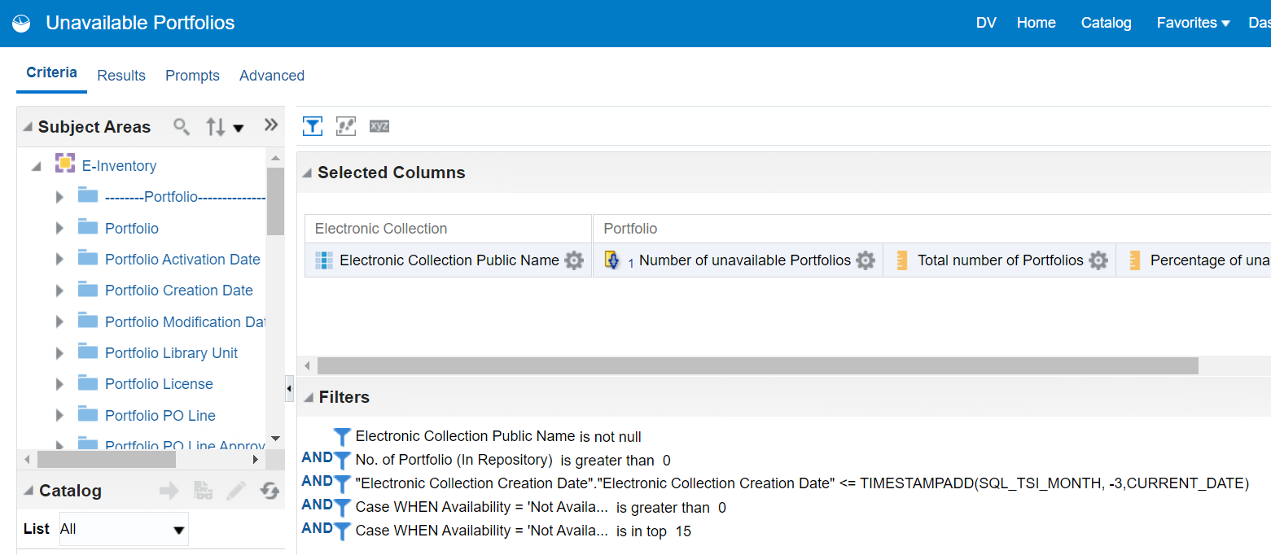
DARA Recommendations Based on Analytics
This is the "Unavailable Portfolios" Analytics report used by DARA
For example, the date filter can be changed by the institution.

Slide 73
DARA Recommendations Based on Analytics
Note that the recommendations from analytics reports are generated via a weekly job "generate recommendations based on Analytics reports".
There is also a weekly job which generates recommendations from within Alma not using Alma Analytics reports.

Slide 74
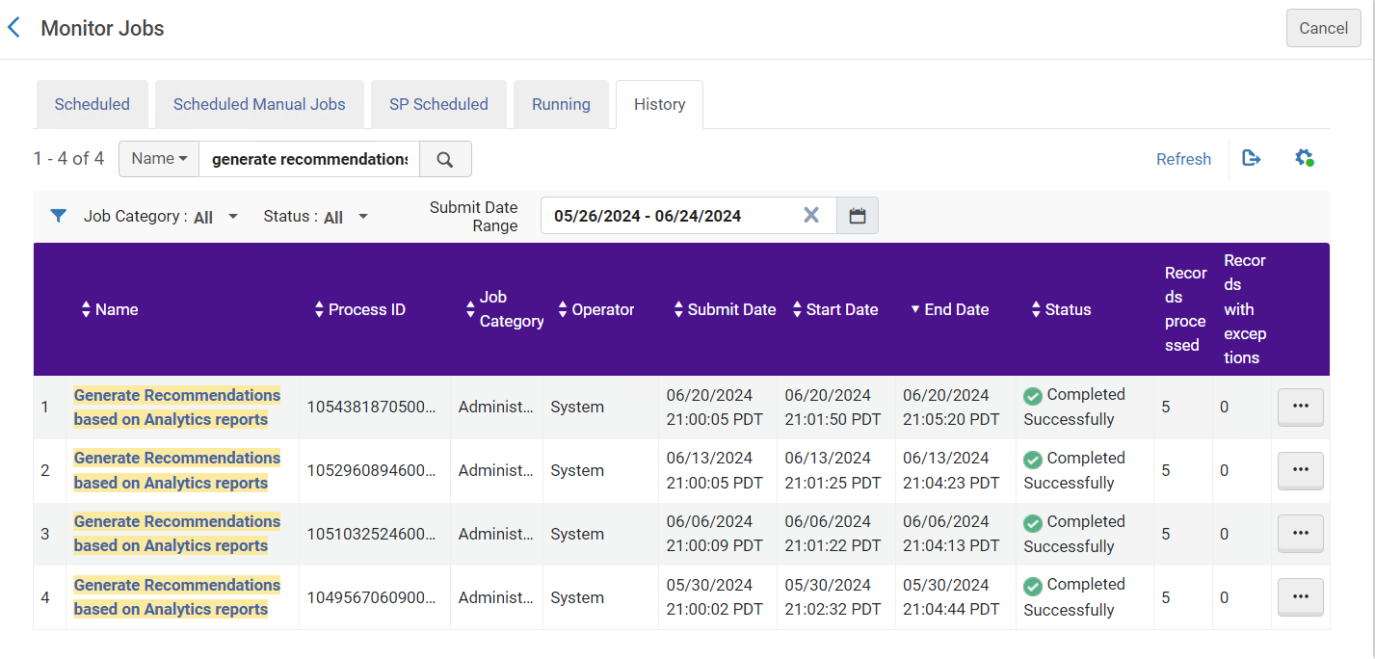
DARA Recommendations Based on Analytics

Slide 75
Live Example – Link Electronic Resources to the Community

Slide 76
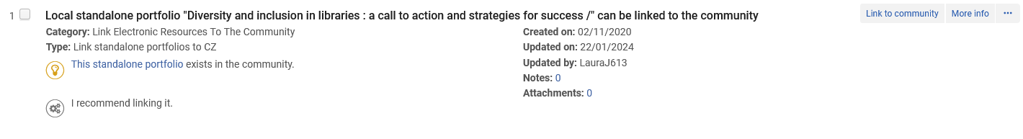
Live Example – Link Electronic Resources to the Community
Here is a recommendation for "Link Electronic Resources to the Community".
DARA identified that the standalone portfolio "Diversity and inclusion in libraries : a call to action and strategies for success /" can be linked to the community.
This would be more efficient than handling a local portfolio.
We will click "More info"

Slide 77
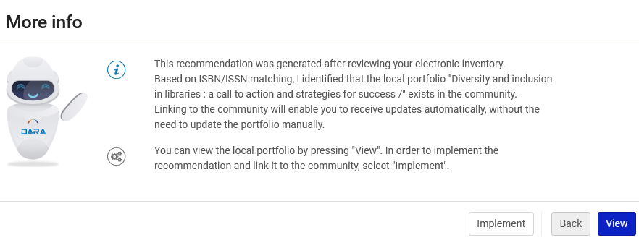
Live Example – Link Electronic Resources to the Community
After reading the informative "More info" we will click "Implement".

Slide 78
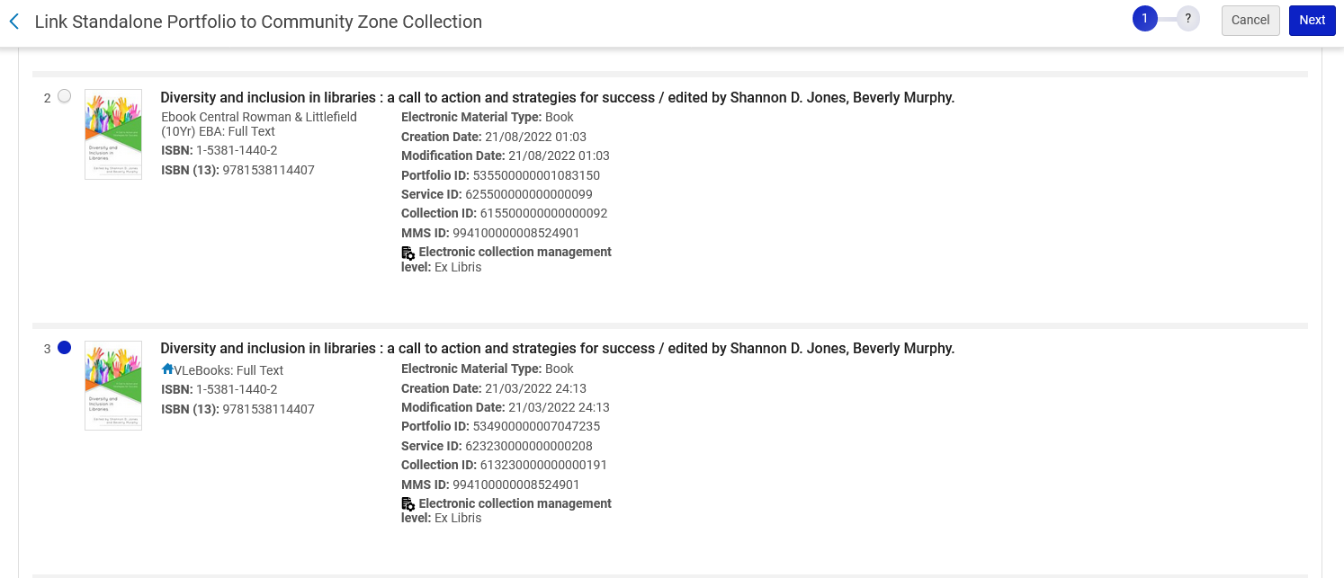
Live Example – Link Electronic Resources to the Community
The portfolios exists in the Community Zone in multiple Electronic Collections. We will select the portfolio to which we want to link and then click "Next".
We will link to the portfolio in Electronic Collection "VLeBooks".
Electronic Collection "VLeBooks".

Slide 79
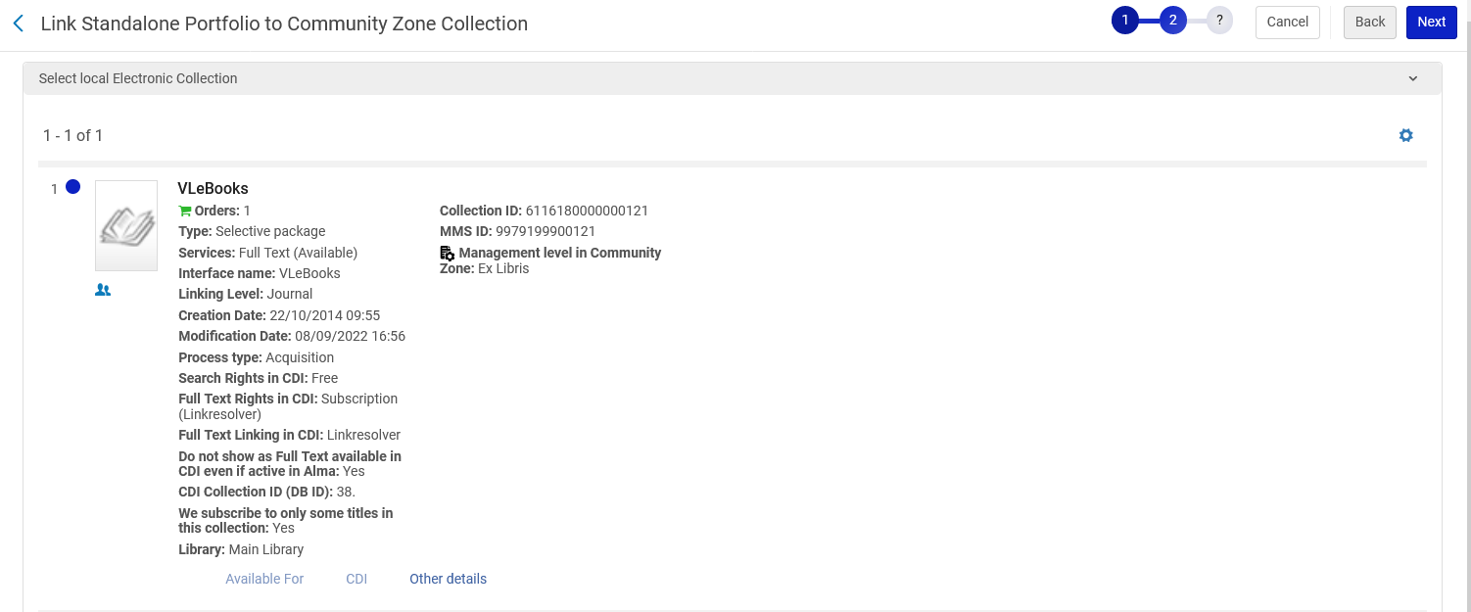
Live Example – Link Electronic Resources to the Community
We now see more details about the Portfolio and Electronic Collection and will click "Next"

Slide 80
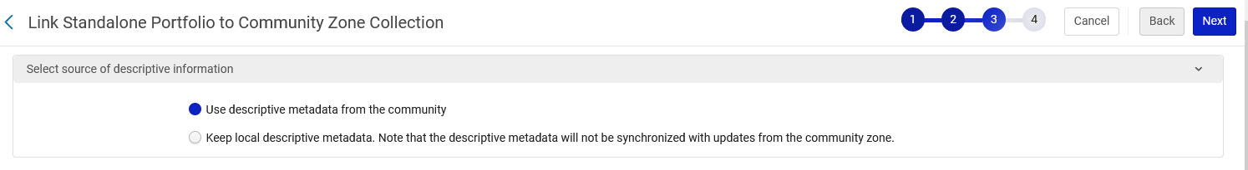
Live Example – Link Electronic Resources to the Community
We will choose to use descriptive metadata from the community and click "Next"

Slide 81
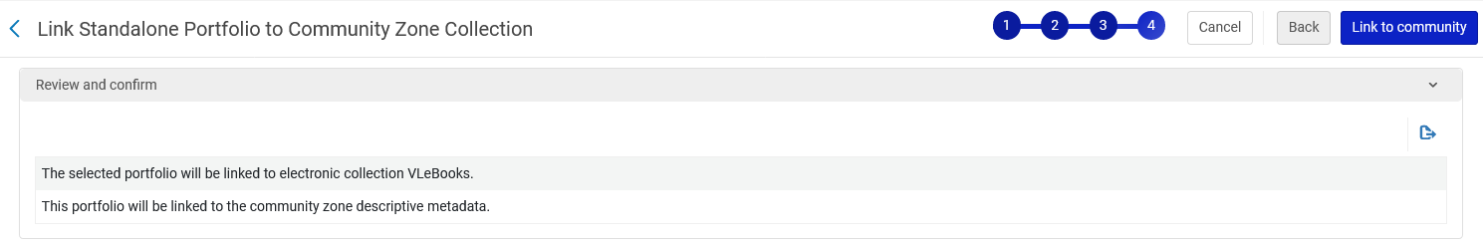
Live Example – Link Electronic Resources to the Community
We get the following notification and click "Link to Community"

Slide 82
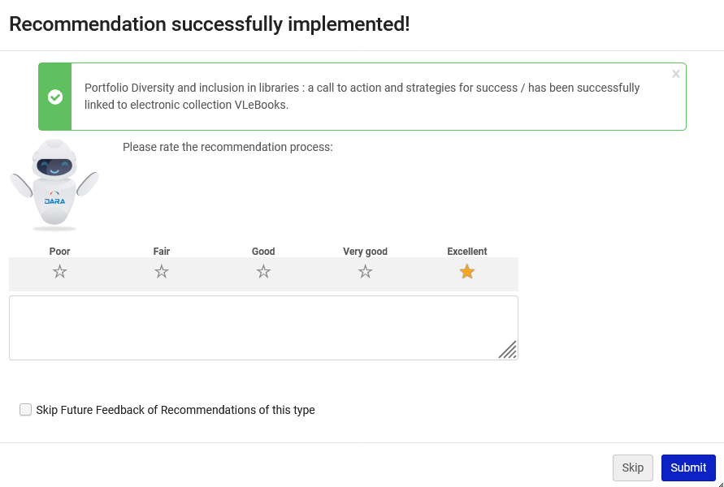
Live Example – Link Electronic Resources to the Community
The recommendation has been implemented

Slide 83
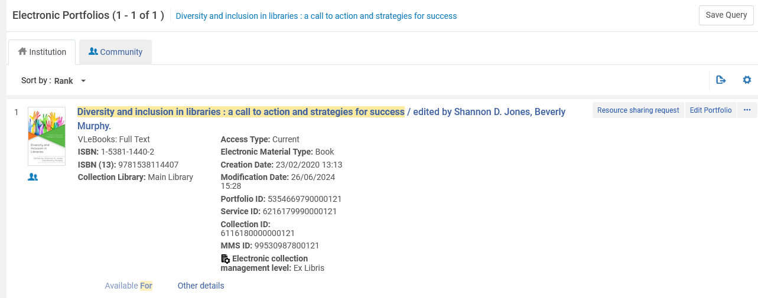
Live Example – Link Electronic Resources to the Community
The portfolio has been linked to the community to Electronic Collection "VLeBooks".

Slide 84
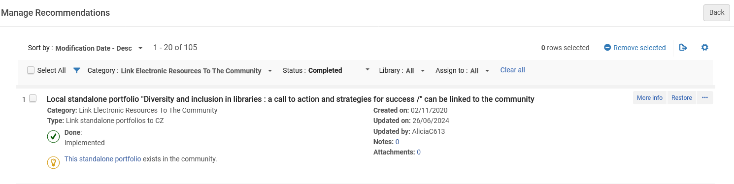
Live Example – Link Electronic Resources to the Community
The DARA Recommendation is now "Done" and "Implemented" with status "Completed"

Slide 85
Live Example – Missing Items

Slide 86
Live Example – Missing Items
We will now look at a DARA Recommendation for "Missing Items".
This DARA Recommendation uses an Analytics report behind the scenes.
DARA identified that Item with AU47634 barcode has been in missing status for a long time. Missing since: 2019-03-06 05:03:25.
While viewing the DARA Recommendation from the list of DARA Recommendations we can click "More info" and then click
  "Implement" to arrive to the list of items from where we can perform various operations such as "Withdraw" or "Toggle Missing Status"
  "View" to see the Analytics report used to build the DARA Recommendation
The final handling of this situation requires human intervention and is not all automatic. This is on purpose and because the library staff needs to decide what to do (if anything) with the missing item (for example check the shelves to see if it really is missing).

Slide 87
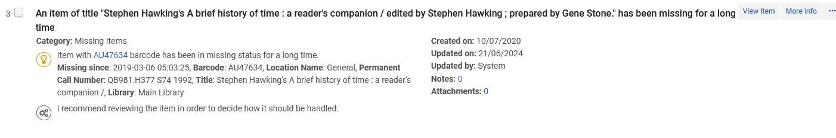
Live Example – Missing Items
We will click "More info"
Barcode AU47634 is part of bibliographic record title "Stephen Hawking's A brief history of time : a reader's companion".

Slide 88
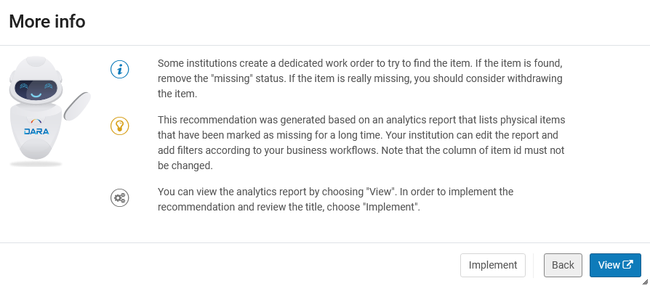
Live Example – Missing Items
If we click the "View" button, we will see the analytics report which was used to create the DARA Recommendation.

Slide 89
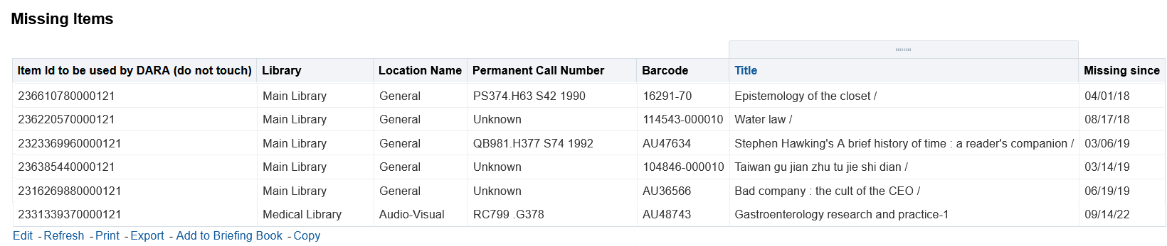
Live Example – Missing Items
This is the barcode of the item which appears in the DARA Recommendation
We clicked View and see the Analytics report
The reason we see "Edit" here is because the staff user has role "Designs Analytics"

Slide 90
Live Example – Missing Items
We will click "Implement" to arrive to the List of Items

Slide 91
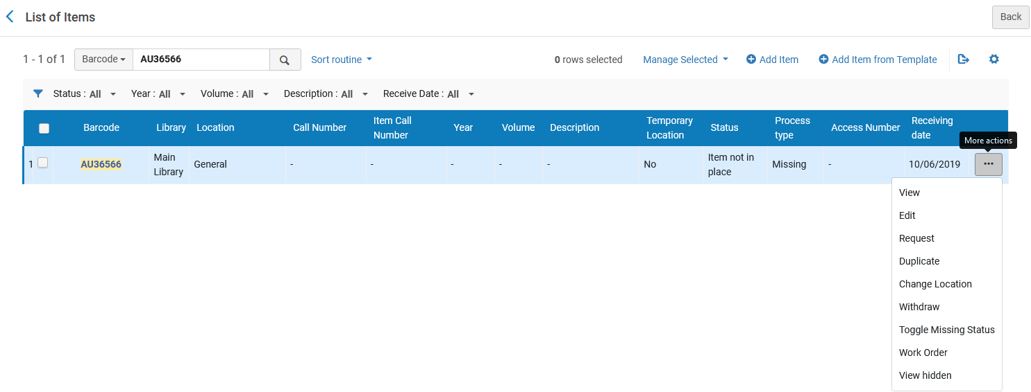
Live Example – Missing Items
We are at the list of items for bibliographic record title "Stephen Hawking's A brief history of time : a reader's companion" filtered by the specific barcode of the DARA Recommendation
Here we can perform a specific action on the item such as "Withdraw" or "Toggle Missing Status"

Slide 92
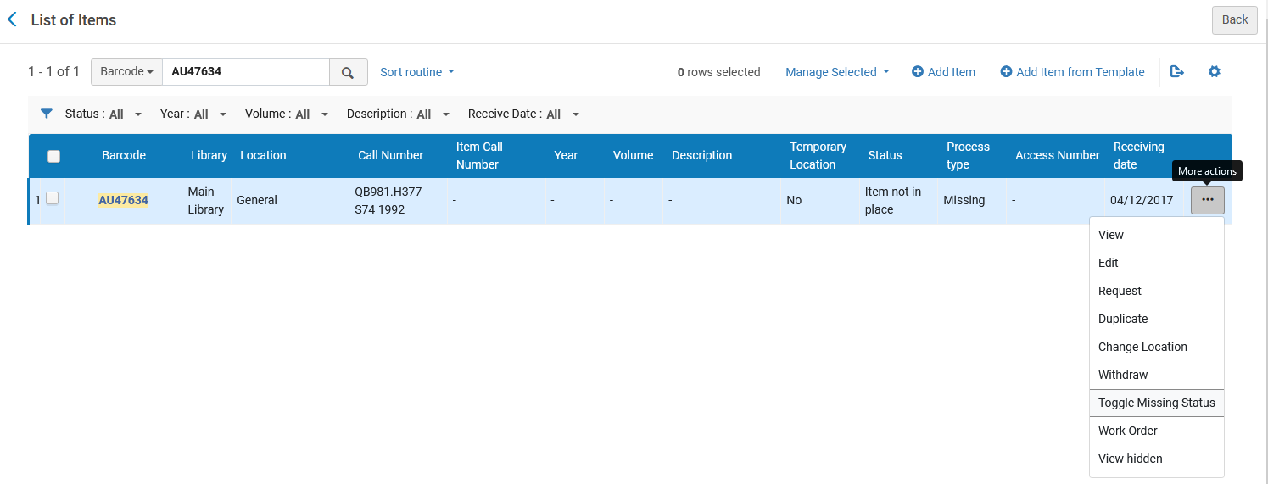
Live Example – Missing Items
We found the item on the shelves and therefore will "Toggle Missing Status"

Slide 93

Live Example – Missing Items
The Missing Status was removed, and the item is in place.

Slide 94

Live Example – Missing Items
When complete the DARA Recommendation can be removed

Slide 95

Live Example – Missing Items
After clicking "Remove" we confirm the removal of the DARA Recommendation

Slide 96

Live Example – Missing Items
The DARA Recommendation is now in status completed and includes the Remove Recommendation Reason and Comment

Slide 97
Live Example – Identical OCLC Control Number

Slide 98
Live Example – Identical OCLC Control Number
We will now look at a DARA Recommendation for "Identical OCLC Control Number".
This DARA Recommendation uses an Analytics report behind the scenes.
DARA identified that for OCLC Control Number 7336985 there are 8 titles.
While viewing the DARA Recommendation from the list of DARA Recommendations we can create a set of the titles and then view the set.
We can also click "More info" and then click
  "Implement" to see an "All Titles" repository search for the OCLC Control Number.
  "View" to see the Analytics report used to build the DARA Recommendation
The final handling of this situation requires human intervention and is not all automatic. This is on purpose and because the library staff needs to decide what to do (if anything) with the duplicate titles.

Slide 99

Live Example – Identical OCLC Control Number
We will click "More info"

Slide 100

Live Example – Identical OCLC Control Number
If we click the "View" button, we will see the analytics report which was used to create the DARA Recommendation.

Slide 101

Live Example – Identical OCLC Control Number
We clicked View and see the Analytics report
This is the OCLC Control Number which appears in the DARA Recommendation
The reason we see "Edit" here is because the staff user has role "Designs Analytics"

Slide 102
Live Example – Identical OCLC Control Number
We will click "Implement" to see an "All Titles" repository search for the OCLC Control Number

Slide 103

Live Example – Identical OCLC Control Number
An "All Titles" repository search for the OCLC Control Number is automatically performed
There are eight results, as stated in the DARA Recommendation

Slide 104

Live Example – Identical OCLC Control Number
From the repository search results of the DARA Recommendation for Identical OCLC Control Number, the institution needs to decide what to do with the duplicate records.
It may be, for example, to delete the duplicates.
It might also be that the OCLC Control Numbers are erroneous for one or more of the bibliographic records.
When complete, the DARA Recommendation can be removed

Slide 105
Thank You

